Slide 1
Differentiable Programming for Data-driven Modeling, Optimization, and Control
MARS Seminar
University of Washington
Ján Drgoňa

Slide 2

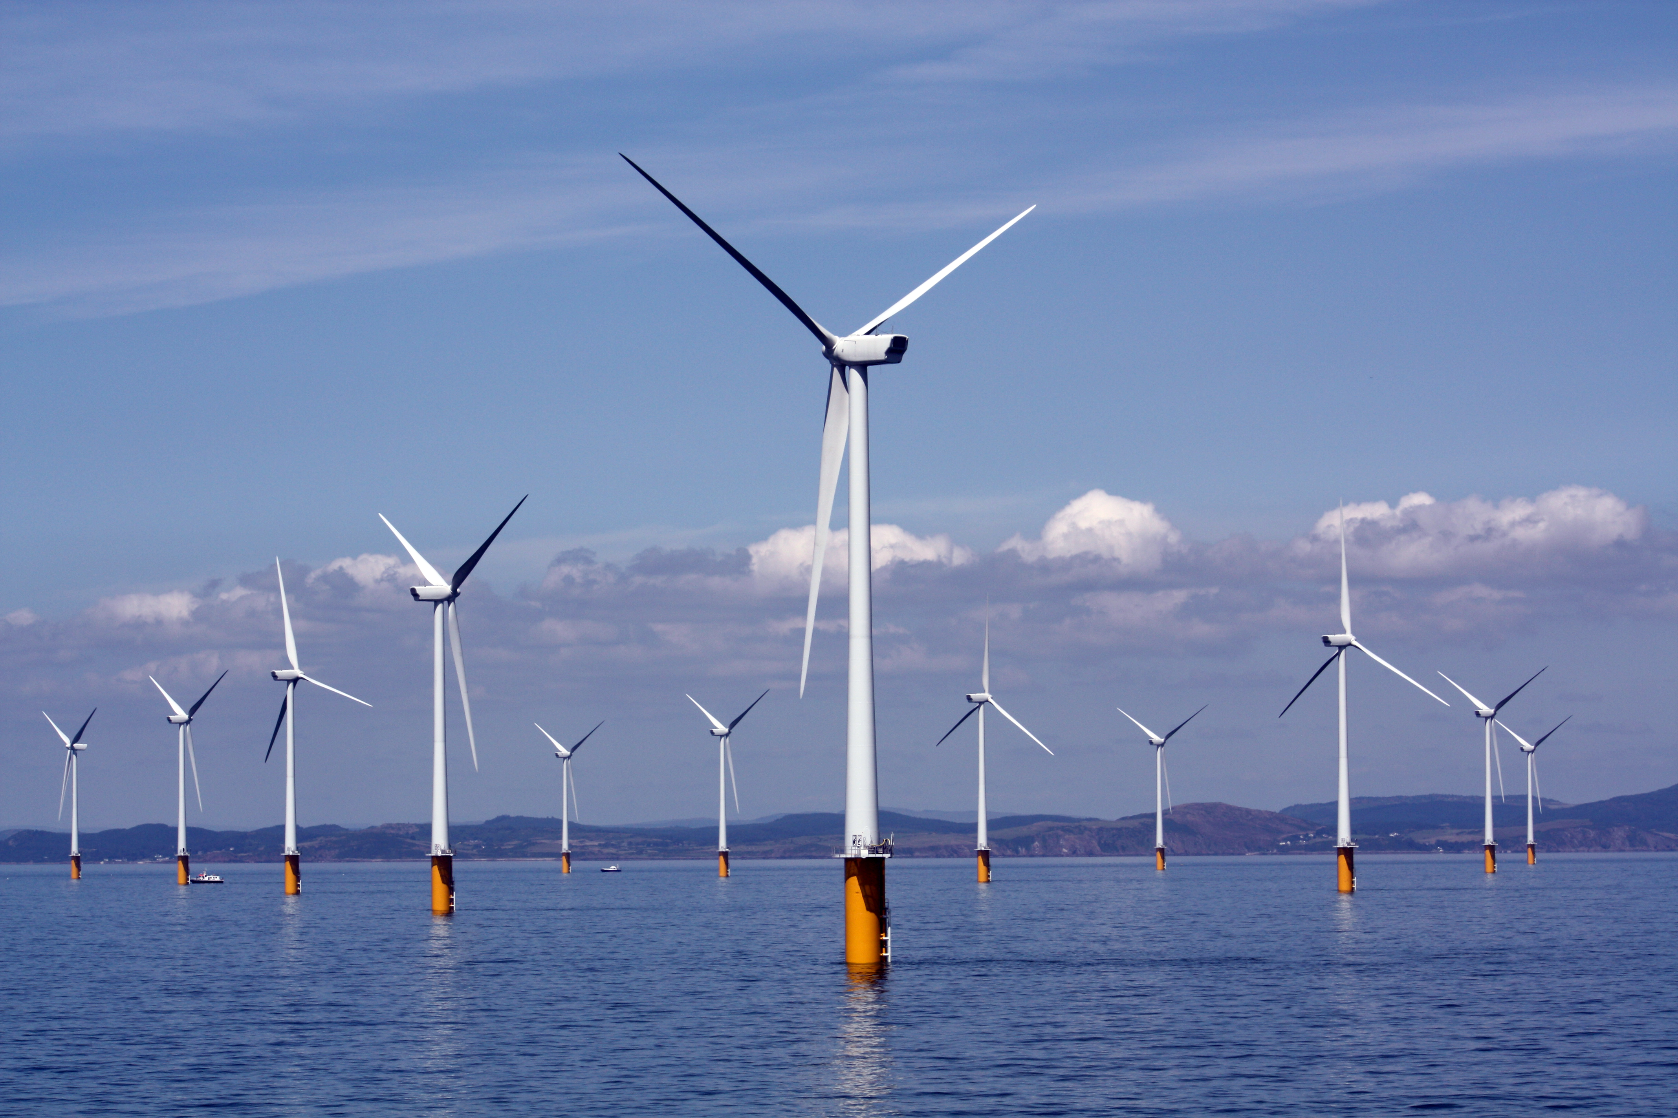
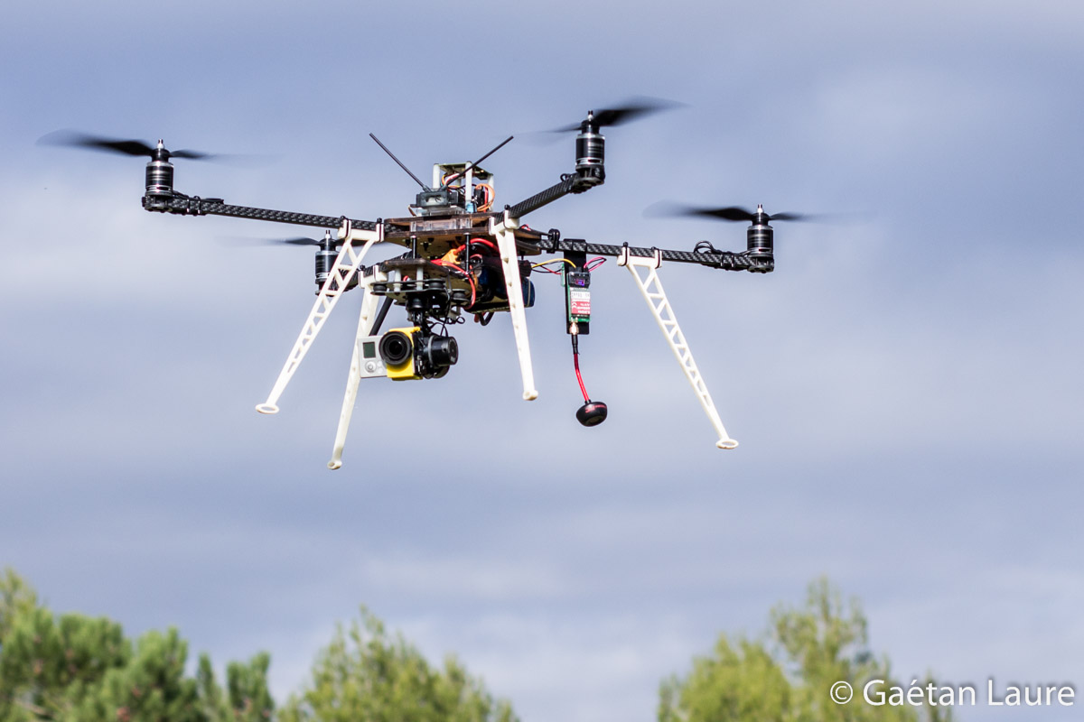
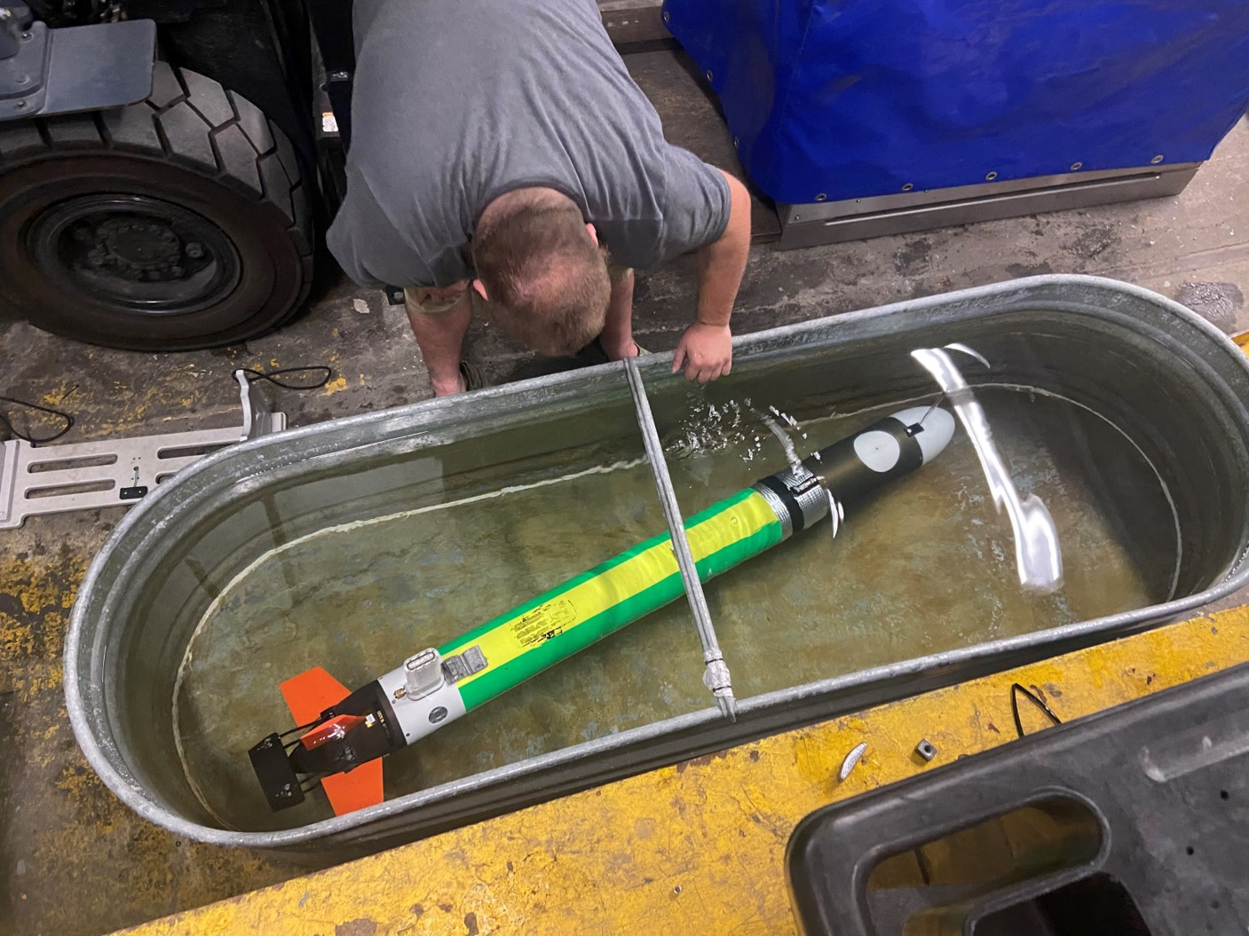
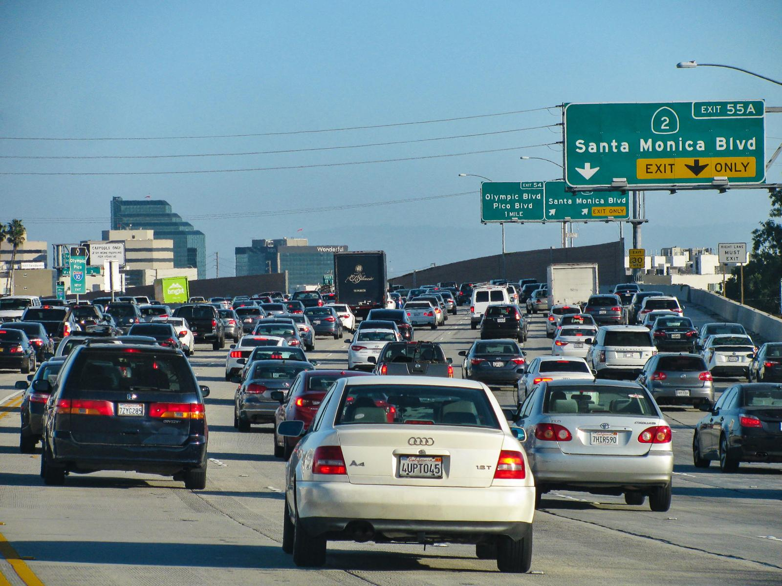
Motivation
Simulations are crucial for many areas of decision-making and scientific discovery
Need: Improve computational efficiency and scalability for heterogenous scientific simulations
Challenges:
Modeling and simulation of complex systems is hard
Optimal control and closed-loop decision-making for complex systems is hard-er
Scientific computing and machine learning tools are fragmented and not easily composable

Slide 3
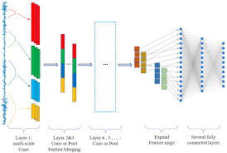
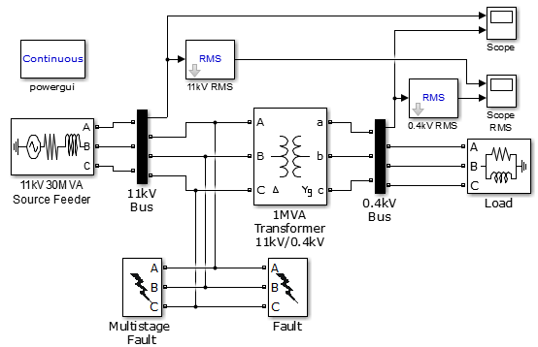
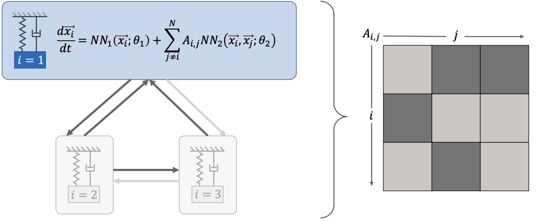
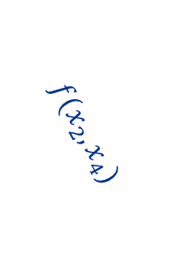
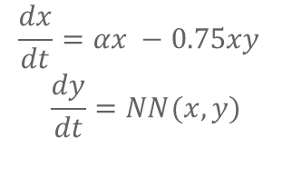

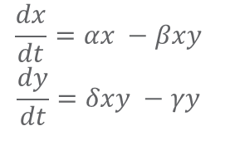
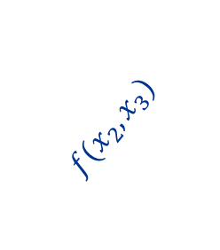
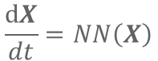
Challenge 1: Heterogenous Modeling Methods
White-box
Gray-box
Black Box
$$\frac{dx}{dt}=αx −βxy$$
$$\frac{dy}{dt}=δxy −γy$$
$$\frac{dx}{dt}=αx −0.75xy$$
$$\frac{dy}{dt}=NN(x,y)$$
$$\frac{dX}{dt}=NN\left(X\right)$$
More domain knowledge
Less domain knowledge
physics-based
networked neural ODEs
neural differential equations
state space models
physics priors
graph neural networks
3
$$f(x_{2},x_{3})$$
$$f(x_{2},x_{1})$$
1
2
$$f(x_{2},x_{4})$$
4

Slide 4

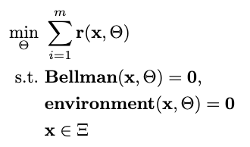

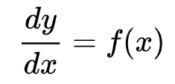

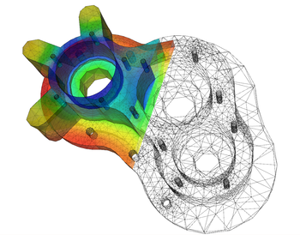
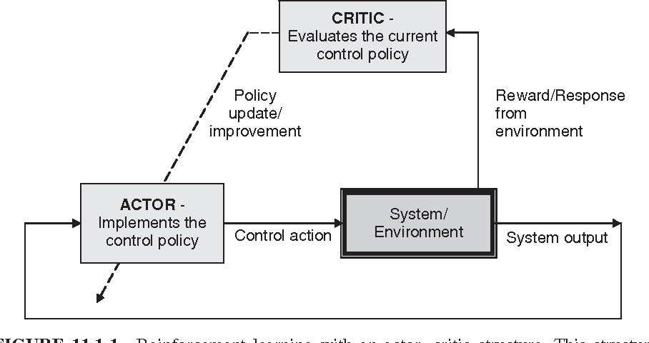

Challenge 2: Heterogenous Solution Methods
Constrained optimization
Differential equations
Supervised Learning
Reinforcement Learning
Requires prior knowledge of objective function and constraints
Requires prior knowledge of the physics to be modeled
Requires large labeled datasets
Requires environment model to sample
More domain knowledge
Less domain knowledge

Slide 5

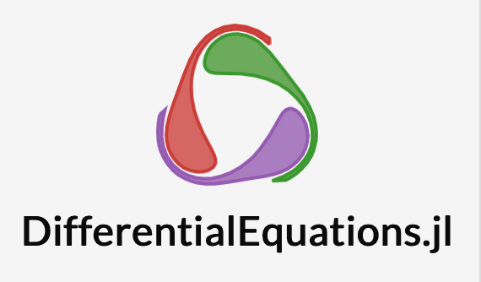


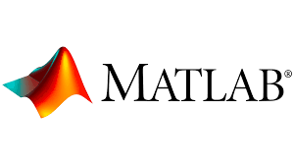




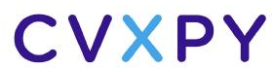


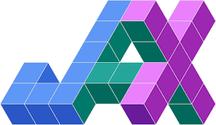



Challenge 3: Heterogenous Solution Tools
Constrained optimization
Differential Equations
Supervised Learning
Reinforcement Learning
More domain knowledge
Less domain knowledge

Slide 6
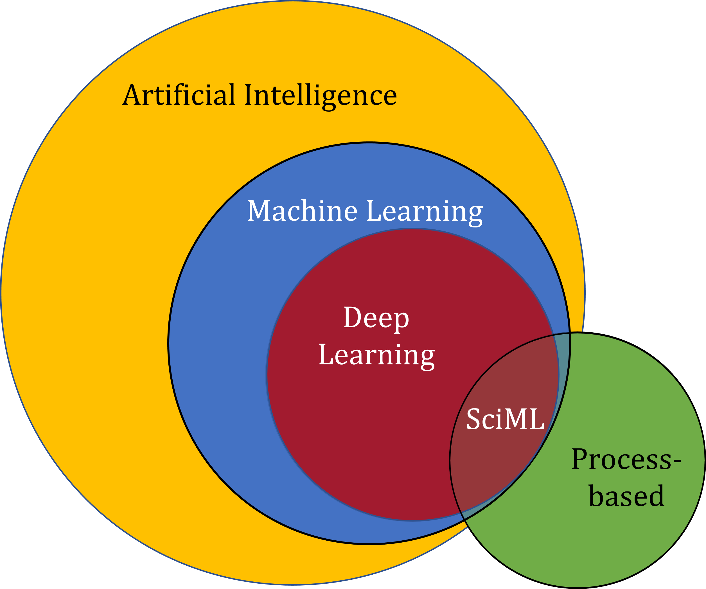
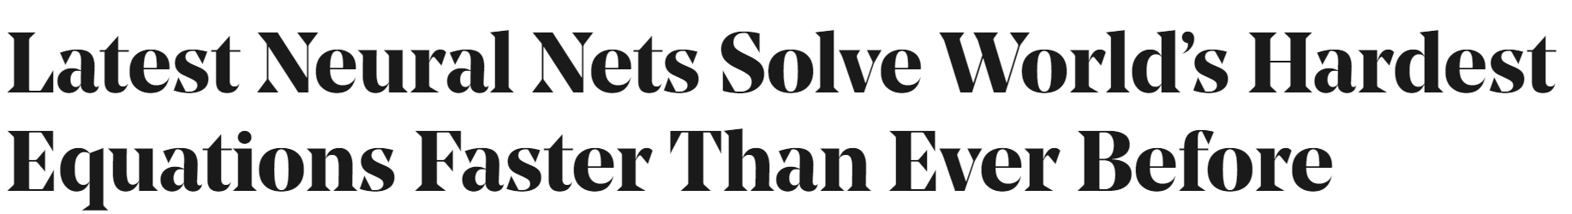

Scientific Machine Learning (SciML)
What?
SciML or Physics-Informed Machine learning (PIML) systematically integrates ML with models and algorithms developed in traditional scientific and engineering domains
Why?
Scientific applications are governed by fundamental principles and physical constraints
Purely data-driven “black box” ML methods cannot satisfy underlying physics
How?
Leverage automatic differentiation to enable learning for modeling, optimization, and control
Image source: https://sciml.wur.nl/reviews/sciml/sciml.html

Slide 7
Selected Scientific Machine Learning Literature
Differentiable Programming
M. Innes, et al., A Differentiable Programming System to Bridge Machine Learning and Scientific Computing, 2019
Learning to Solve (L2S)
M. Raissi, et al., Physics-informed neural networks: A deep learning framework for solving forward and inverse problems involving nonlinear partial differential equations, 2019
Learning to Optimize (L2O)
A. Agrawal, et al., Differentiable Convex Optimization Layers, 2019
P. Donti, et al., DC3: A learning method for optimization with hard constraints, 2021
J. Kotary, et al., End-to-End Constrained Optimization Learning: A Survey, 2021
Learning to Model (L2M)
B. Lusch, et al., Deep learning for universal linear embeddings of nonlinear dynamics, 2018
R. T. Q. Chen, et al., Neural Ordinary Differential Equations, 2019
C. Rackauckas, et al., Universal Differential Equations for Scientific Machine Learning, 2021
Learning to Control (L2C)
B. Amos, et al., Differentiable MPC for End-to-end Planning and Control, 2019
S. East, et al., Infinite-Horizon Differentiable Model Predictive Control, 2020
Y Qiao, et al., Scalable Differentiable Physics for Learning and Control, 2020

Slide 8

Can We Unify Different Scientific Machine Learning Methods in a Coherent Algorithmic Framework?
a: Learning to Model (L2M)
c: Learning to Control (L2C)
b: Learning to Solve (L2S)
d: Learning to Optimize (L2O)

Slide 9
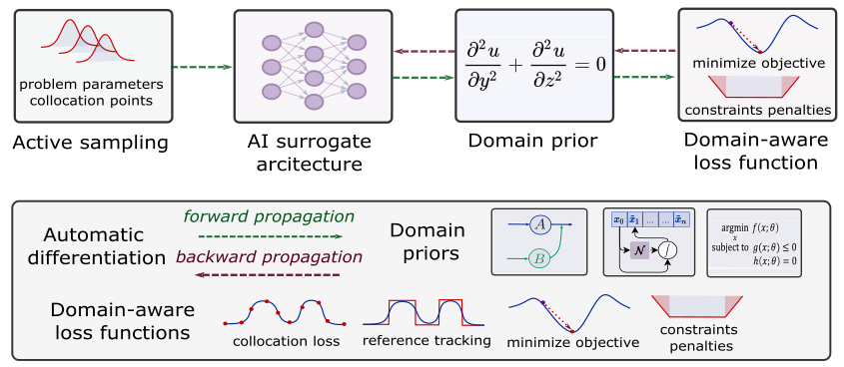
Can We Unify Different Scientific Machine Learning Methods in a Coherent Algorithmic Framework?
Sampling methods
Machine learning component
Domain inductive priors
Domain-aware loss functions

Slide 10
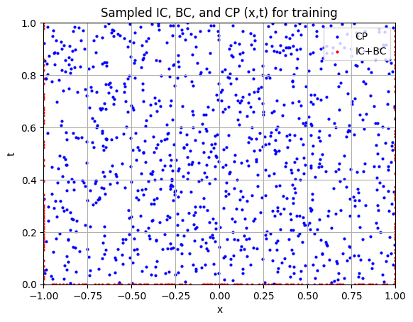
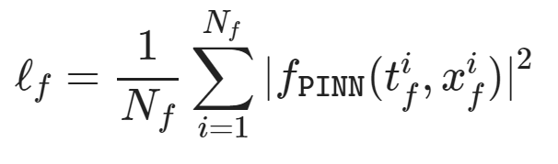
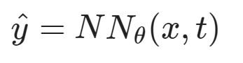
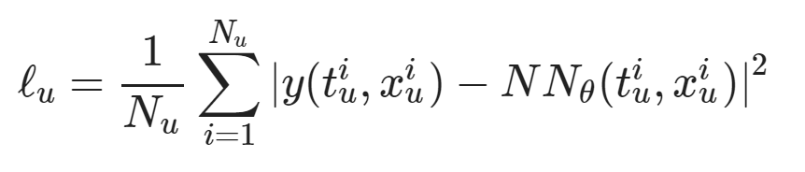
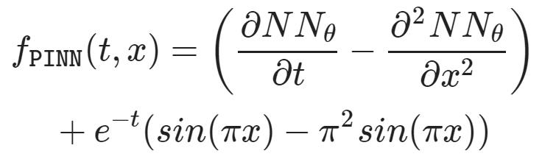
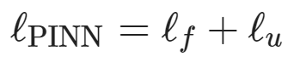
Learning to Solve Differential Equations with Physics-Informed Neural Networks (PINNs)
Dataset: collocation points in the spatio-temporal coordinates.
Architecture: PDE equations solved with neural network via automatic differentiation.
Loss function: minimizing PDE equation, initial and boundary condition residuals.
https://github.com/pnnl/neuromancer/blob/master/examples/PDEs/Part_2_PINN_BurgersEquation.ipynb
M. Raissi, et al., Physics-informed neural networks: A deep learning framework for solving forward and inverse problems involving nonlinear partial differential equations, Journal of Computational Physics, 2019

Slide 11
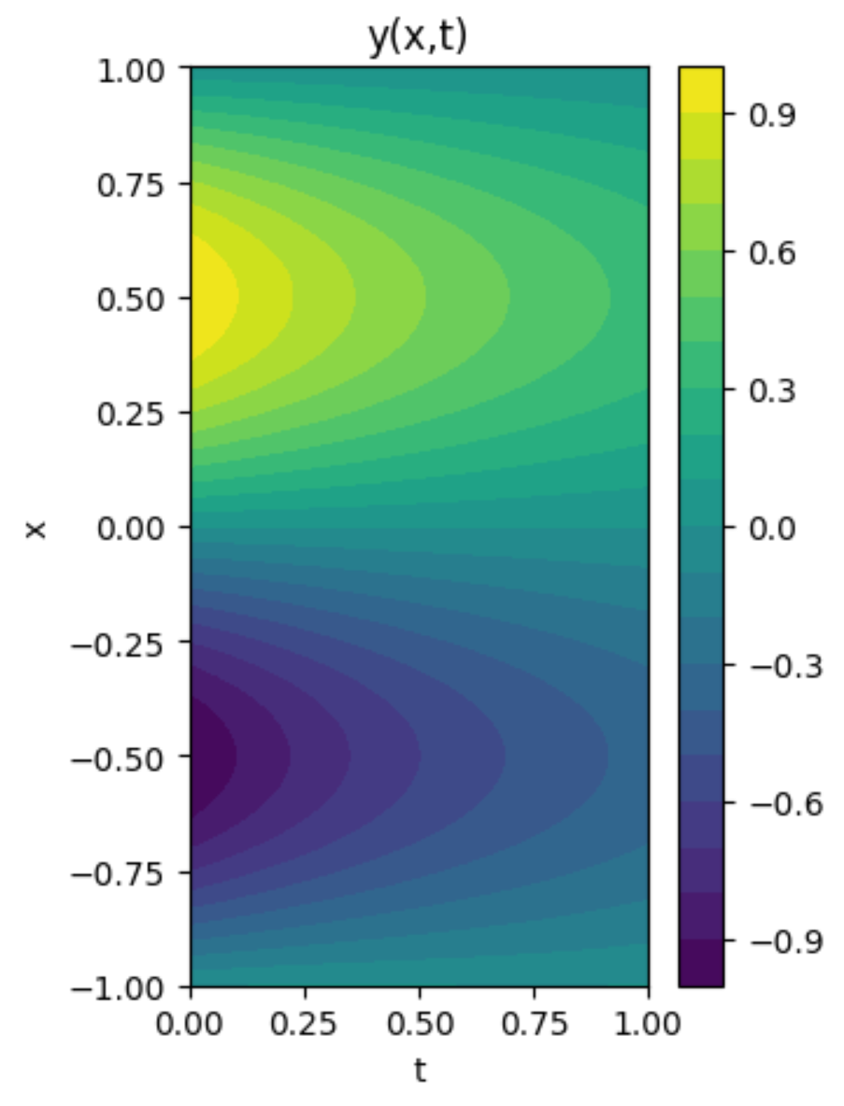
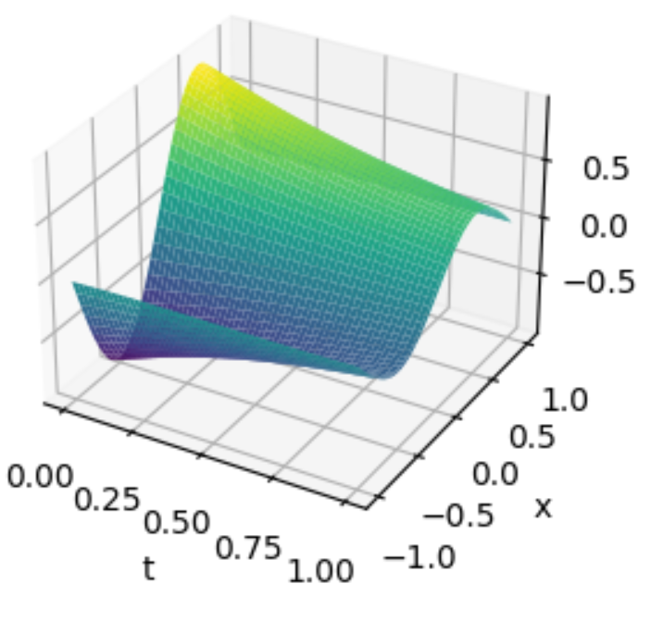
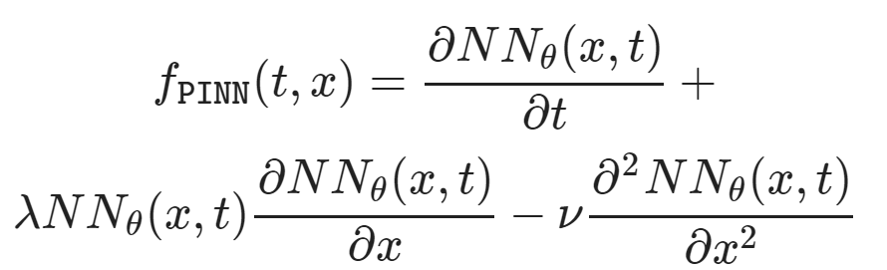
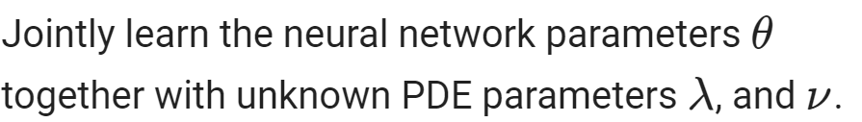
Learning to Solve Differential Equations with Physics-Informed Neural Networks (PINNs)
Training neural networks as PDE solutions
Parameter estimation from data (inverse modeling)

Slide 12
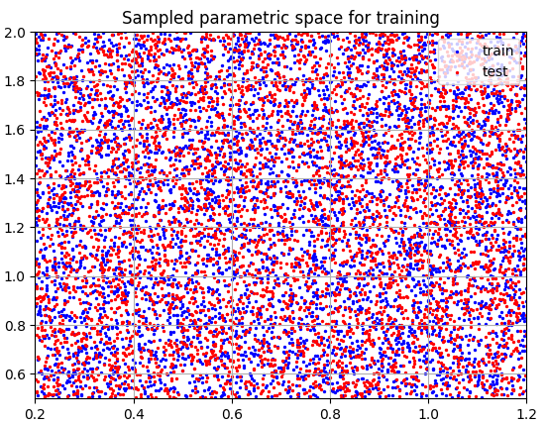
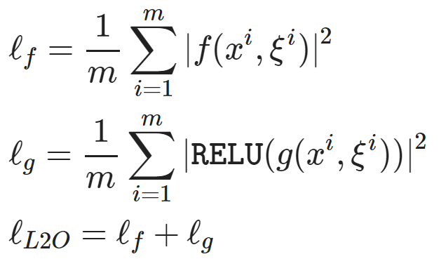
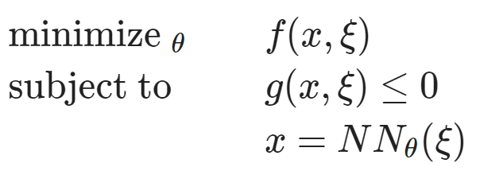
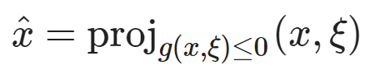
Learning to Optimize (L2O) with Constraints
Dataset: collocation points in the parametric space.
Architecture: differentiable optimization solver with neural network surrogate.
Loss function: minimizing objective function and constraints penalties.
https://github.com/pnnl/neuromancer/blob/master/examples/parametric_programming/Part_1_basics.ipynb
A. Agrawal, et al., Differentiable Convex Optimization Layers, 2019
P. Donti, et al., DC3: A learning method for optimization with hard constraints, 2021

Slide 13
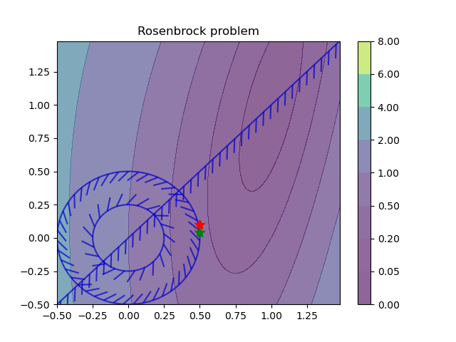
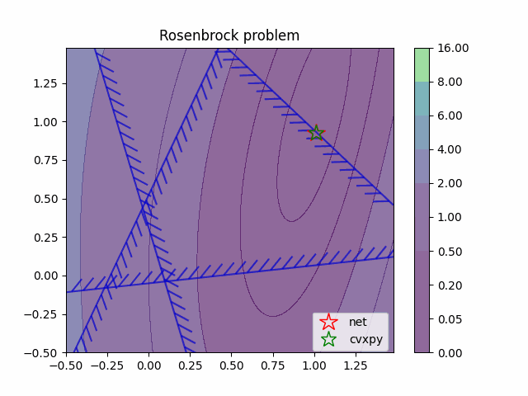
Learning to Optimize (L2O) with Constraints
Training neural networks as parametric solutions
Feasibility restoration with implicit layers

Slide 14
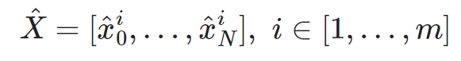
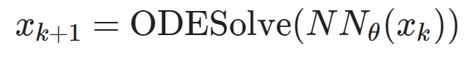
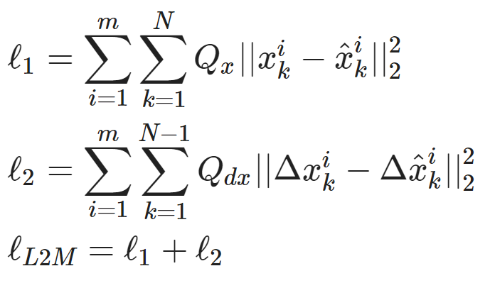
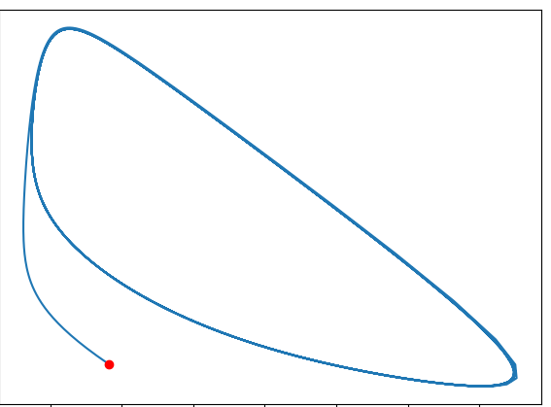
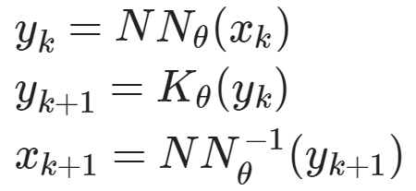
Learning to Model (L2M) with Neural Operators
Dataset: time-series of states, inputs, and disturbances tuples.
Architecture: differentiable ODE solver with neural network model.
Loss function: trajectory matching, regularizations, and constraints penalties.
Architecture: Koopman operator with neural network basis functions.
https://github.com/pnnl/neuromancer/blob/master/examples/ODEs/Part_1_NODE.ipynb
R. T. Q. Chen, et al., Neural Ordinary Differential Equations, 2019
B. Lusch, et al., Deep learning for universal linear embeddings of nonlinear dynamics, 2018

Slide 15
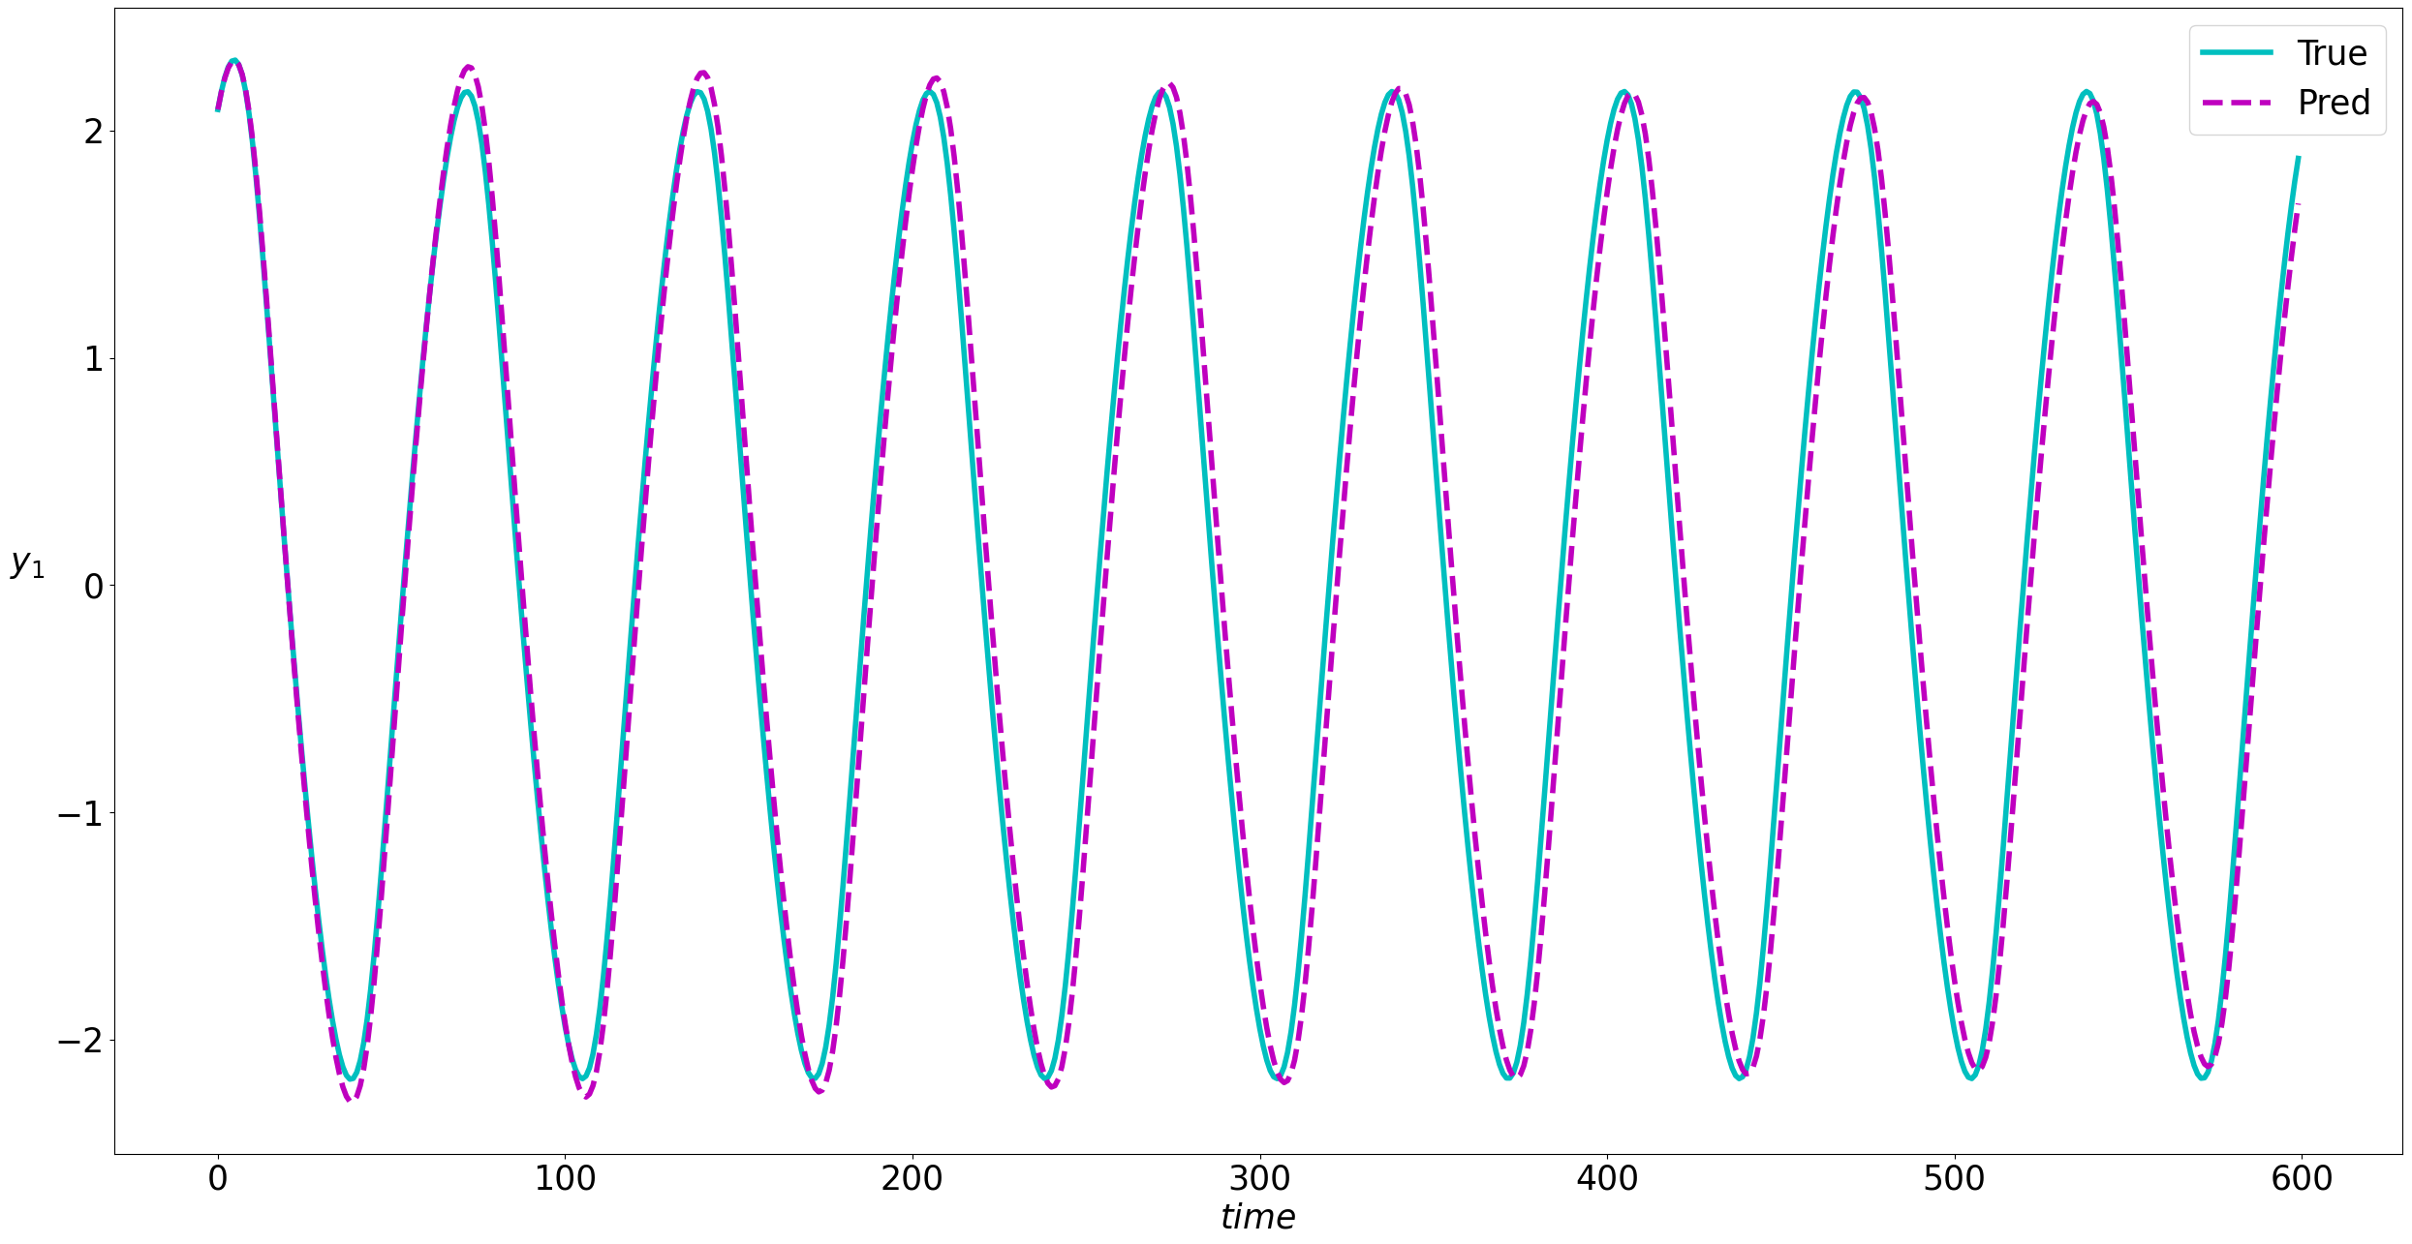
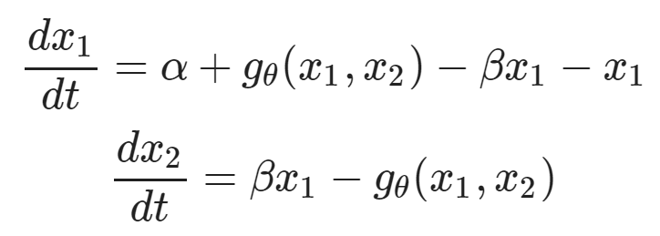
Learning to Model (L2M) with Neural Operators
Neural models for nonlinear system identification
Gray-box parameter estimation
C. Rackauckas, et al., Universal Differential Equations for Scientific Machine Learning, 2021

Slide 16
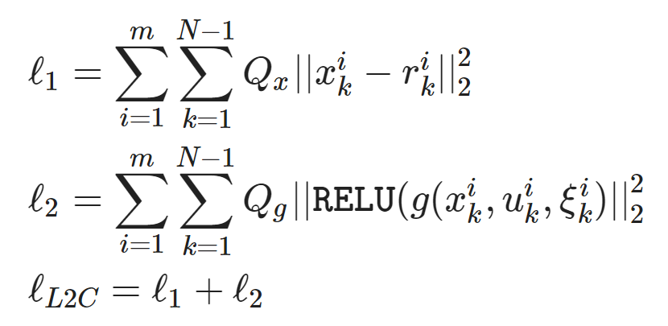
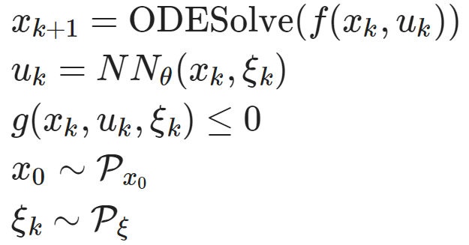
Learning to Control (L2C) with Differentiable System Models
Dataset: collocation points in the control parametric space.
Architecture: differentiable model with neural network control policy.
Loss function: reference tracking, constraints and terminal penalties.
https://github.com/pnnl/neuromancer/blob/master/examples/control/Part_3_ref_tracking_ODE.ipynb
Jan Drgona, et al., Differentiable Predictive Control: An MPC Alternative for Unknown Nonlinear Systems using Constrained Deep Learning, Journal of Process Control, 2022

Slide 17
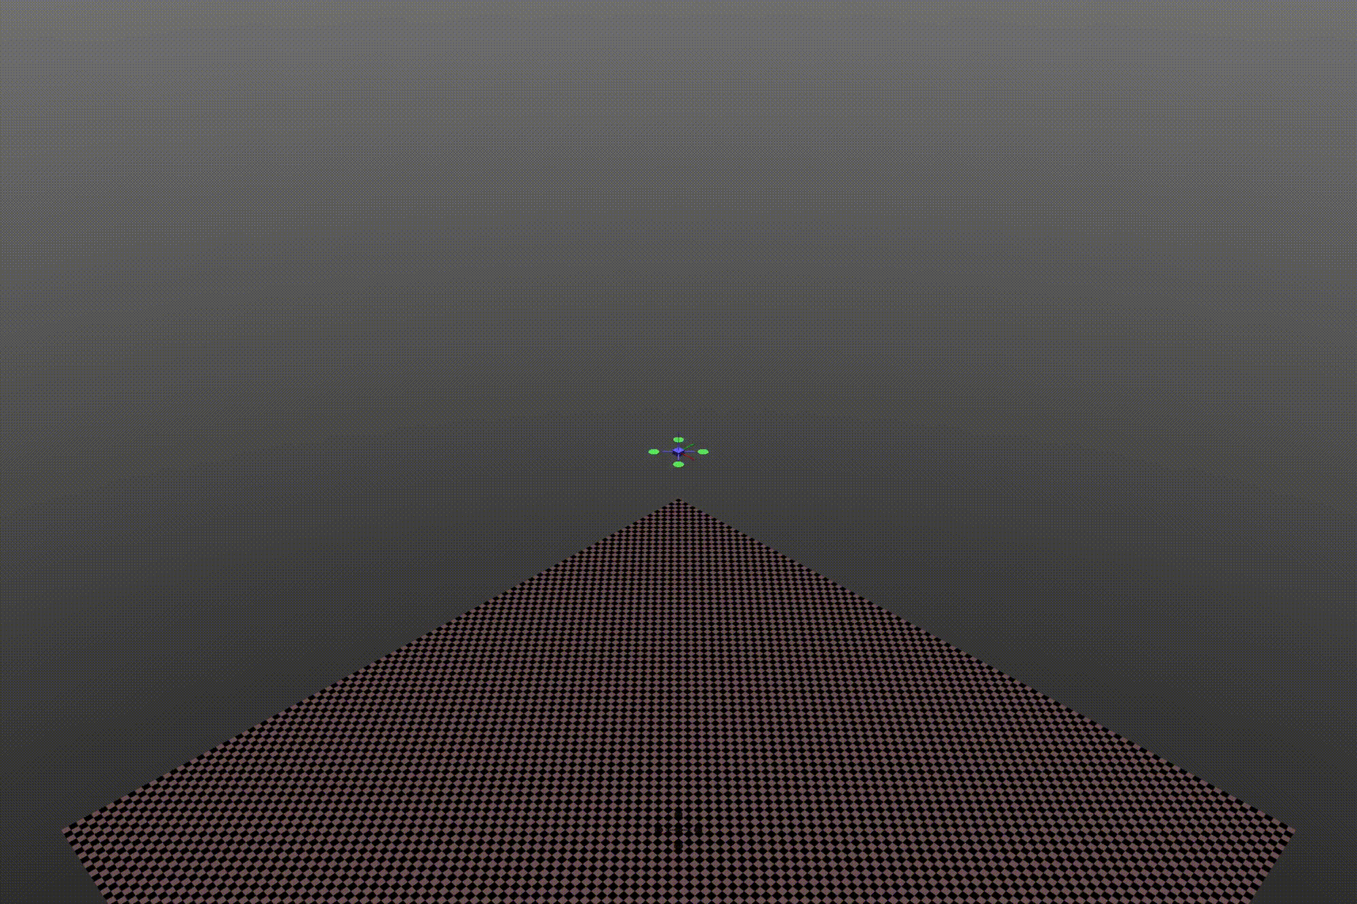
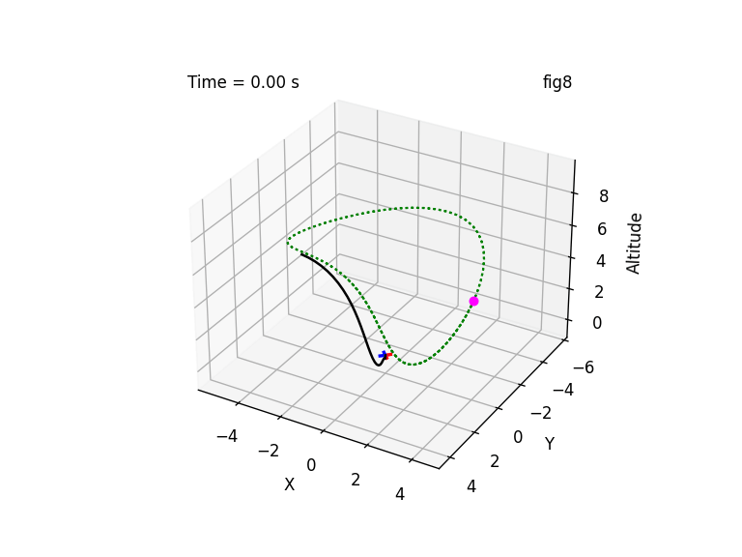

Learning to Control (L2C) with Differentiable System Models
Trajectory optimization for dynamical systems
Learning stabilizing controllers

Slide 18
Towards Unified Scientific Machine Learning Framework
Karniadakis, G.E., Kevrekidis, I.G., Lu, L. et al. Physics-informed machine learning. Nat Rev Phys 3, 2021.
Thiyagalingam, J., Shankar, M., Fox, G. et al. Scientific machine learning benchmarks. Nature Reviews Physics 4, 413–420, 2022.
Nghiem T., Drgona J., et al. Physics-Informed Machine Learning for Modeling and Control of Dynamical Systems, ACC, 2023.

Slide 19





NeuroMANCER Scientific Machine Learning Library
1. Mathematical formulation
3. Problem graph
map
2. Python code interface
4. Results
import neuromancer as nm
p = nm.variable(‘p’)
x = nm.variable(‘x’)
y = nm.variable('y’)
obj = ((1-x)**2 + p*(y-x**2)**2).minimize(weight=1.0, name='obj’) c1 = (p/2)**2 <= x**2 + y**2
c2 = x**2 + y**2 <= p**2
c3 = x >= y net = nm.MLP(insize=2, outsize=2, hsizes=[80]*4) map = nm.Node(net, input_keys=['p’], output_keys=[‘x’,‘y’])
loss = nm.PenaltyLoss([obj], [c1, c2, c3]) problem = nm.Problem([map], loss)
optimizer = torch.optim.AdamW(problem.parameters()) trainer = nm.Trainer(problem,data,optimizer)
best_model = trainer.train()

Slide 20









Open-Source Success
github.com/pnnl/neuromancer
PyTorch SciML toolkit
User-friendly API
Interactive tutorials
Community engagement
NeuroMANCER
VOLTTRON
HyperNetX
Core Development Team
Ján Drgoňa
Diff Predictive Control
Aaron Tuor
Deep Learning
Madelyn Shapiro
Deep Learning
Rahul Birmiwal
Software Development
James Koch
Dynamical Systems
Draguna Vrabie
Predictive Control

Slide 21










Funding & Partnerships
Developed by internal investments …
… and now supporting a portfolio of sponsor-funded projects worth over $20M
Strategic industrial partnerships and collaborations
Notes:
Dynamic decarbonization through autonomous physics-centric deep learning and optimization of building operations - DOE BTO $1,000K total budget
Advancing Market-Ready Building Energy Management by Cost-Effective Differentiable Predictive Control - DOE BTO - $5,440K total budget
Data-Driven Decision Control for Complex Systems (DnC2S) - DOE ASCR - $1,200K total budget
AutonomIA – ARPA-e - $5,891K total budget
Addressing Challenges in Energy: Floating Wind in a Changing Climate (ACE-FWICC)- WTO, ASCR - $5,000K total budget
(MOLUcQ) Uncertainty Quantification for Multifidelity Operator Learning, ASCR - $1,650K total budget

Slide 22
Contributions to Learning to Optimize (L2O) Methods
[1] Ethan King, James Kotary, Ferdinando Fioretto, Jan Drgoňa, Metric Learning to Accelerate Convergence of Operator Splitting Methods for Differentiable Parametric Programming, Under review for CDC 2024.
[2] S. Abhyankar, J. Drgoňa, A. Tuor and A. August, "Neuro-physical dynamic load modeling using differentiable parametric optimization," 2023 IEEE Power & Energy Society General Meeting (PESGM), Orlando, FL, USA, 2023
[3] S. Li, J. Drgoňa, A. Tuor, L. Pileggi, D. Vrabie, Homotopy Learning of Parametric Solutions to Constrained Optimization Problems, https://openreview.net/forum?id=GdimRqV_S7, 2023

Slide 23




Metric Learning to Accelerate Convergence of Operator Splitting Methods
Parametric programming setting:
Douglas-Rachford splitting (DR) algorithm:
We can accelerate convergence of DR and ADMM algorithms via end-to-end metric learning.
Idea: Train neural network to optimize the metric as a function of problem parameters:
Ethan King, James Kotary, Ferdinando Fioretto, Jan Drgona, Metric Learning to Accelerate Convergence of Operator Splitting Methods for Differentiable Parametric Programming, Under review for CDC 2024.

Slide 24


Metric Learning is a Form of Active Set Prediction
Ethan King, James Kotary, Ferdinando Fioretto, Jan Drgona, Metric Learning to Accelerate Convergence of Operator Splitting Methods for Differentiable Parametric Programming, Under review for CDC 2024.

Slide 25
Contributions to Learning to Model (L2M) Methods
[1] J. Koch, M. Shapiro, H. Sharma, D. Vrabie, J. Drgoňa, Neural Differential Algebraic Equations, arXiv:2403.12938, 2024.
[2] Ziyao Yang, et al., Physics-constrained graph modeling for building thermal dynamics, Energy and AI, 2024.
[3] J. Koch, et al., Structural Inference of Networked Dynamical Systems with Universal Differential Equations, Chaos, 2023.
[4] Yu Wang, et al., Semi-Supervised Learning of Dynamical Systems with Neural Ordinary Differential Equations: A Teacher-Student Model Approach, AAAI, 2023
[5] C. Legaard, et al., Constructing neural network based models for simulating dynamical systems, ACM Computing Surveys, 2023.
[6] W. Shaw Cortez, et al., Domain-aware Control-oriented Neural Models for Autonomous Underwater Vehicles, IFAC-PapersOnLine, 2023.
[7] J. Drgoňa, A. Tuor, S. Vasisht and D. Vrabie, Dissipative Deep Neural Dynamical Systems, in IEEE Open Journal of Control Systems, 2022.
[8] A. Rahman, J. Drgoňa, A. Tuor and J. Strube, Neural Ordinary Differential Equations for Nonlinear System Identification, ACC, 2022.
[9] J. Drgoňa, et al., On the Stochastic Stability of Deep Markov Models, NeurIPS, 2021.
[10] J. Drgoňa, et al., Physics-constrained deep learning of multi-zone building thermal dynamics, Energy and Buildings, 2021.
[11] E. Skomski, et al., Constrained Block Nonlinear Neural Dynamical Models, ACC, 2021.
[12] E. Skomski, et al., Automating discovery of physics-informed neural state space models via learning and evolution, L4DC, 2021.
[13] A. Tuor, J. Drgoňa, D. Vrabie, Constrained Neural Ordinary Differential Equations with Stability Guarantees, ICLR Workshop on Integration of Deep Neural Models and Differential Equations, arXiv:2004.10883, 2020.

Slide 26



Neural Differential Algebraic Equations
Trained with physics-informed loss function:
Time stepper architecture is inspired by Lie-Trotter operator splitting method:
Inverse modeling, robustness to noise and, out of distribution generalization.
J. Koch, M. Shapiro, H. Sharma, D. Vrabie, J. Drgona, Neural Differential Algebraic Equations, arXiv:2403.12938, 2024.

Slide 27


Networked Dynamical Systems via Universal Differential Equations (UDEs)
Network of unknown oscillators
Coupling adjacency
Generalization of learned dynamics on never-seen network topology.
Ground truth Kuramoto system:
James Koch, et al., Structural Inference of Networked Dynamical Systems with Universal Differential Equations, Chaos: An interdisciplinary Journal of Nonlinear Science, doi.org/10.1063/5.0109093, 2023

Slide 28
Contributions to Learning to Control (L2C) Methods
[1] J. Drgoňa, et al., Learning Constrained Adaptive Differentiable Predictive Control Policies With Guarantees, IEEE Transactions on Systems, Man, and Cybernetics: Systems, 2024.
[2] J. Viljoen, et al., Differentiable Predictive Control for Robotics: A Data-Driven Predictive Safety Filter Approach, under review at IROS, 2024.
[3] W. Shaw Cortez, et al., Robust Differentiable Predictive Control with Safety Guarantees: A Predictive Safety Filter Approach, arXiv:2311.08496, 2023
[5] T. X. Nghiem, et al., Physics-Informed Machine Learning for Modeling and Control of Dynamical Systems, ACC, 2023.
[6] D. Soudbakhsh, et al., Data-Driven Control: Theory and Applications, ACC, 2023.
[7] J. Drgoňa, et al., Differentiable Predictive Control: An MPC Alternative for Unknown Nonlinear Systems using Constrained Deep Learning; Journal of Process Control, 2022.
[8] W. Shaw Cortez, et al., Differentiable Predictive Control with Safety Guarantees: A Control Barrier Function Approach, CDC, 2022.
[9] S. Mukherjee, et al., Neural Lyapunov Differentiable Predictive Control, CDC, 2022.
[10] E. King, et al., Koopman-based Differentiable Predictive Control for the Dynamics-Aware Economic Dispatch Problem, ACC, 2022.
[11] S. Sinha, et al., Data-driven Stabilization of Discrete-time Control-affine Nonlinear Systems: A Koopman Operator Approach, ECC 2022.
[12] J. Drgoňa, et al., Learning Stochastic Parametric Differentiable Predictive Control Policies, IFAC-PapersOnLine, 2022.
[13] J. Drgoňa, et al., Deep Learning Explicit Differentiable Predictive Control Laws for Buildings, IFAC NMPC 2021.

Slide 29



Learning Stable Policies with Neural Lyapunov Functions
Sayak Mukherjee, Ján Drgoňa, Aaron Tuor, Mahantesh Halappanavar, Draguna Vrabie, Neural Lyapunov Differentiable Predictive Control, Conference on Decision and Control (CDC), 2022

Slide 30




Learning Safe Policies with Control Barrier Functions
Wenceslao Shaw Cortez, et al., Differentiable Predictive Control with Safety Guarantees: A Control Barrier Function Approach, Conference on Decision and Control (CDC), 2022

Slide 31



Learning to Control Building Energy System
Architectures
Neural state space dynamics model
MLP control policy architecture
Results
Multi-input multi-output system dynamics
Dynamic economic control objective
Parametric constraints
Jan Drgona, Aaron Tuor, Elliott Skomski, Soumya Vasisht, Draguna Vrabie, Deep Learning Explicit Differentiable Predictive Control Laws for Buildings, IFAC NMPC 2021

Slide 32


Learning to Control Dynamics-Aware Economic Dispatch
Problem: Current dispatch processes do not incorporate system dynamics concerns. Incorporating dynamics in economic dispatch is too complex and time-consuming.
Architectures
Koopman dynamics model
CNN control policy
Solution: Machine-learning based dynamics-aware dispatch. Learn system dynamics and control policies for faster assessment.
Results
5 orders of magnitude speed-up
Near optimal performance
Ethan King, Ján Drgoňa, Aaron Tuor, Shrirang Abhyankar, Craig Bakker, Arnab Bhattacharya, Draguna Vrabie, Koopman-based Differentiable Predictive Control for the Dynamics-Aware Economic Dispatch Problem, 2022 American Control Conference

Slide 33






Learning to Model Underwater Vehicle Dynamics
Gray-box nonlinear hydrodynamic model using Universal Differential Equations
Gray-box
Black-box
W. Shaw Cortez, et al., Domain-aware Control-oriented Neural Models for Autonomous Underwater Vehicles, IFAC, 2023.

Slide 34


Learning to Control for Robotic Systems
J. Viljoen, et al., Differentiable Predictive Control for Robotics: A Data-Driven Predictive Safety Filter Approach, under review at IROS, 2024.

Slide 35
Edge Deployment of Differentiable Predictive Control
Flexy-Air system sketch with Raspberry-Pi controller
Proof of concept for AI on the edge platform.
Jan Drgona, Karol Kis, Aaron Tuor, Draguna Vrabie, Martin Klauco, Differentiable Predictive Control: An MPC Alternative for Unknown Nonlinear Systems using Constrained Deep Learning; Journal of Process Control, 2022

Slide 36



Summary
NeuroMANCER open-source scientific machine learning (SciML) library integrating deep learning, constrained optimization, physics-based modeling, and control in a coherent framework
Learning to optimize (L2O)
Learning to control (L2C)
Learning to model (L2M)
Learning to solve (L2S)
github.com/pnnl/neuromancer
www.youtube.com/@neuromancer_SciML
drgona.github.io

Slide 37









Acknowledgements
Aaron Tuor
James Koch
Madelyn Shapiro
Stefan Dernbach
Rahul Birmiwal
Ethan King
Sayak Mukherjee
Wenceslao Shaw Cortez
Soumya Vasisht
Shrirang Abhyankar
Mahantesh Halappanavar
Draguna Vrabie

Slide 38

Differentiable Parametric Programming: Generalization of Physics-informed Neural Networks
Problem formulation:

Slide 39
Differentiable Parametric Programming: Generalization of Physics-informed Neural Networks
Objective function
Problem formulation:
Constraints
Primal optimizers
Scenarios
Solution map
Parameters

Slide 40

Differentiable Parametric Programming: Generalization of Physics-informed Neural Networks
Objective function
Problem formulation:
Constraints
Primal optimizers
Scenarios
Solution map
Parameters
Lagrangian form:
Constraints penalties
Gradient-based optimization

